Slide 1

Writing Business Together

Slide 2
AssuranceAmerica was founded in 1998.
AssuranceAmerica is headquartered in Atlanta, Georgia
AssuranceAmerica writes minimum limits auto insurance & HO4 renters' insurance. (Commercial Auto coming 2025)
AssuranceAmerica has the following products available in each state:
- Alabama: Auto & HO4 Renters
- Arizona: Auto & HO4 Renters
- Florida: Auto (HO4 Renters Insurance Coming Soon!)
- Georgia: Auto & HO4 Renters
- Indiana: Auto & HO4 Renters
- Nebraska: Auto & HO4 Renters
- South Carolina: Auto & HO4 Renters
- Texas: Auto & HO4 Renters
- Virginia: Auto (HO4 Renters Insurance Coming Soon!)
2025 New States
- Oklahoma: Auto & HO4 Renters
- Tennessee: Auto & HO4 Renters
- Ohio: Auto & HO4 Renters
- Pennsylvania: Auto & HO4 Renters

Slide 3
Coverages (Auto):
Comprehensive and Collision
Bodily Injury (BI)
Property Damage (PD)
Uninsured Motorist (UM)
Medical
Personal Injury Protection (PIP)
AD&D (Accidental Death and Dismemberment)
Roadside coverage (Reimbursement up to $75 per incident)
Additional coverages offered (see Underwriting Manual for state specific information)

Slide 4
Coverages (Renters):
Coverage and Limits
Coverage C – Personal Property: $5,000 to $20,000
Coverage D – Loss of Use: 20% of Personal Property (contents)
Coverage E – Personal Liability: $50k or $100k
Deductible
See options in Webrater

Slide 5
Target Markets
We are a State Minimum Limits Auto & HO4 Renters Insurance Company offering competitive rates to all!
Appetite: all minimum limit risk profiles with vehicles 3 years or older and MSRPs under $35K-$45K. POP/no-POP insurance, points/no points, single car, multi-car/multi-driver policies.
Other Features/Highlights Include:
We are a Non-Credit Scoring Company – We don’t run credit!
Strong Retention (62% Retention in 2024!)
Our quoting platform is one of the quickest, cleanest, and easiest to use in the industry and it operates on all browsers and mobile devices.
We integrate with top rating platforms (ITC, EZLynx, Bolt, Vertafore, QRP via EZLynx for now)
We offer extremely competitive rates to customers with a Foreign Driver’s License
We have a bilingual staff at all locations including our corporate headquarters and all 4 claims locations (Atlanta, Dallas, McAllen, Tampa)
We offer a multitude of great discounts

Slide 6
How to Issue A New Policy When Bridging from a Comparative Rater

Slide 7
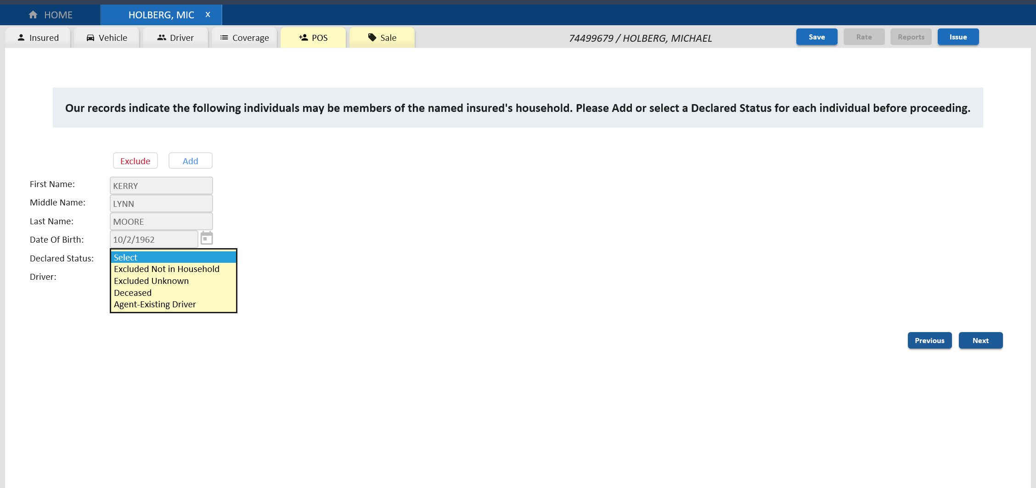
**Possible post bridge screen prior to RC2 rate display.
Note: we run a number of pre-MVR/CLUE reports at bridge. Here is an instance where a possible additional drivers where discovered. Agent must take action here in order to move forward.
On some occasions, when bridging from a Comparative Rater, if other individuals are found, the landing page will be the Point of Sale (POS) tab. You will be required to add or exclude any potential household members identified.

Slide 8
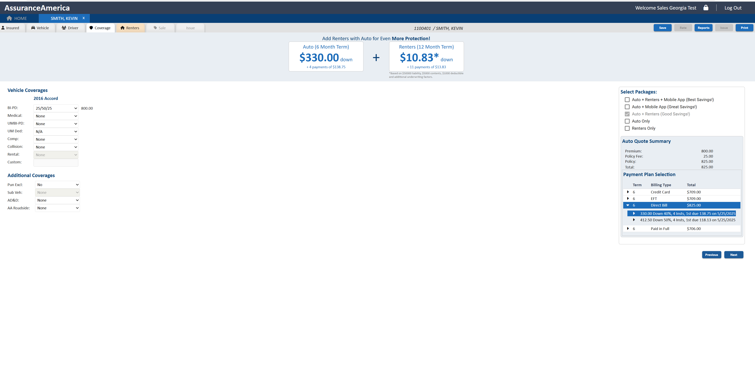
**Landing page for states offering both Auto and Renters Insurance.
Auto + Renters highlighted
Note Select Package box with Auto + Renters checked

Slide 9
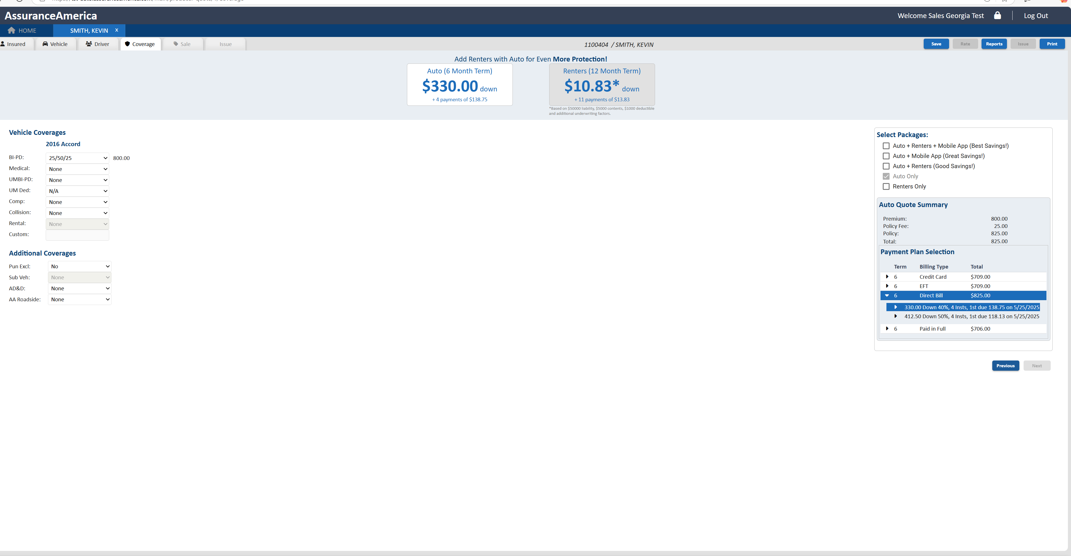
**Landing page for states offering both Auto and Renters Insurance.
Auto only!
The Renters (12-Month Term) rate is displayed, but the box is grayed out, and the + sign has been removed. There is “no” Renter's tab across the top.
In Select Packages Box, change to Auto only and click Rate button at top to get Auto only rate
After new rate and payment plans confirmed, run Reports. **Majority of time rate will not change post MVR and CLUE runs

Slide 10
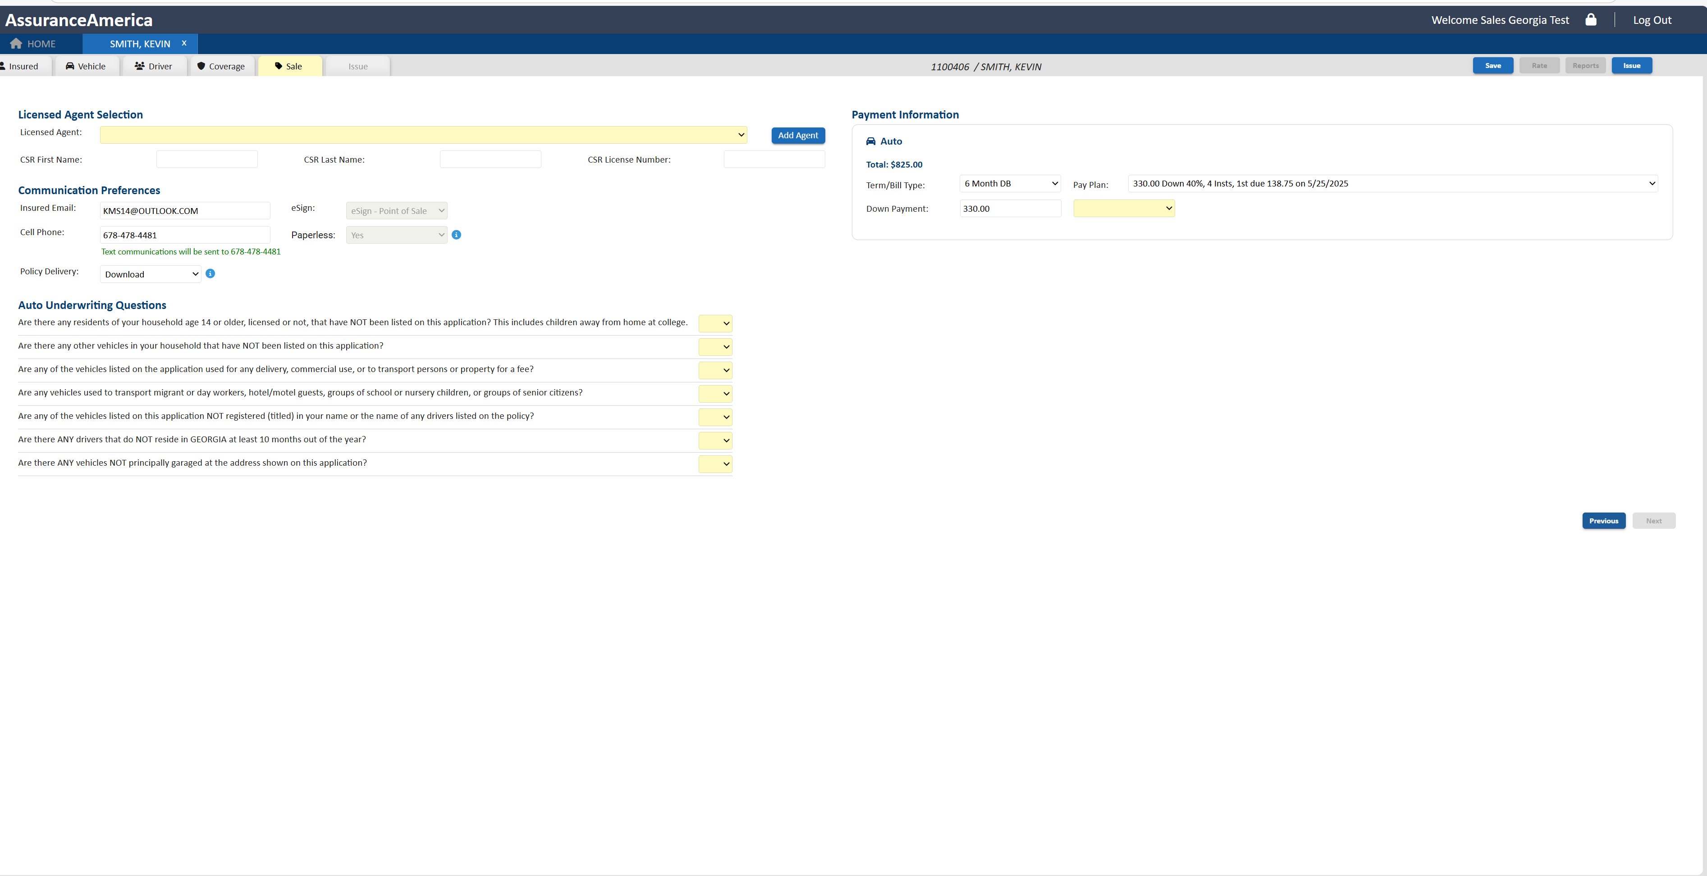

Sale Tab
Sale Tab
Licensed Agent Selection
This section allows agents to select their name from the dropdown menu. If their name is not listed, they must click "Add Agent" and enter their information exactly as it appears on their license. This information will be stored for future policies.
Underwriting Questions & Down Payment Selection
Once reviewed, proceed to select the appropriate down payment options.
After completion, hit Issue tab

Slide 11
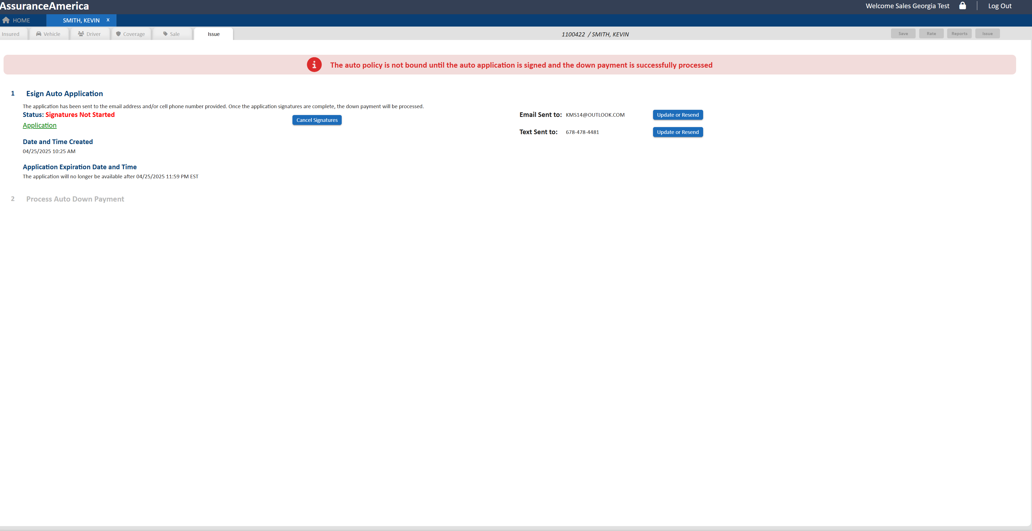
Issue Tab
Issue Tab
With Issue initiated, Applicant will be texted and email policy documents for signatures
Esign Auto Application status will change as applicant navigates through application. From signatures “Not Started” to “Started” and then “Completed”
Note: we will not process payment until signatures are completed.
Sale Tab

Slide 12
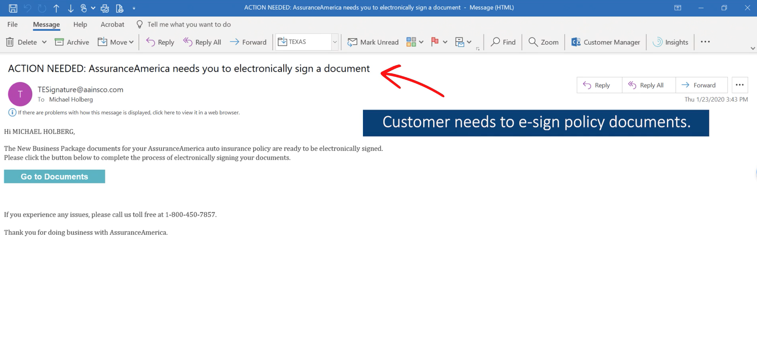
Screenshot of sample customer email:
The insured will need to click “Go to Documents”.

Slide 13
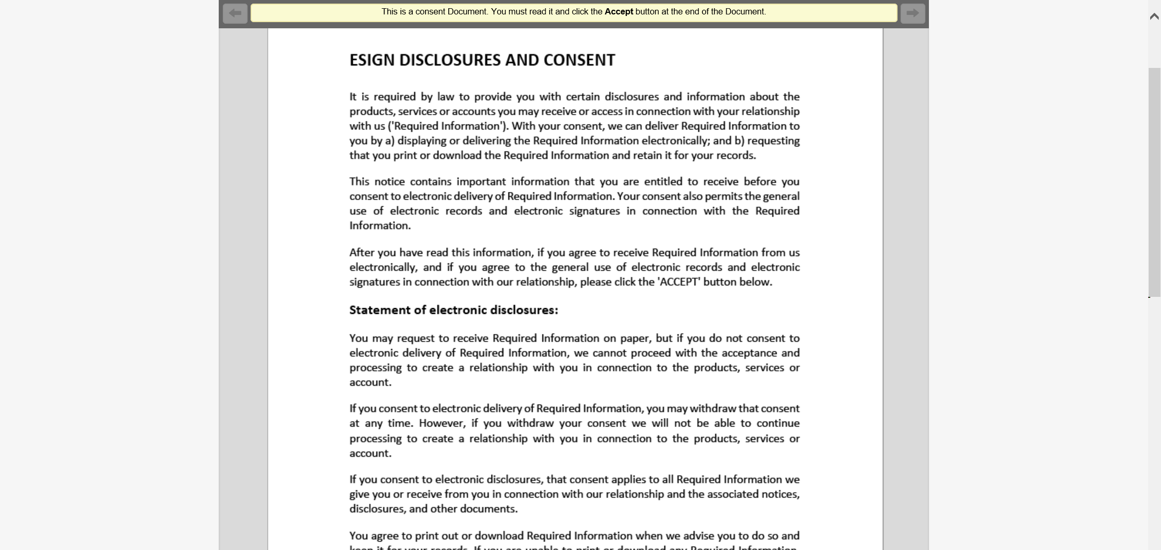
The insured will be directed to the eSign disclosure form. After reviewing it, they will need to click “accept” at the bottom of the page.

Slide 14
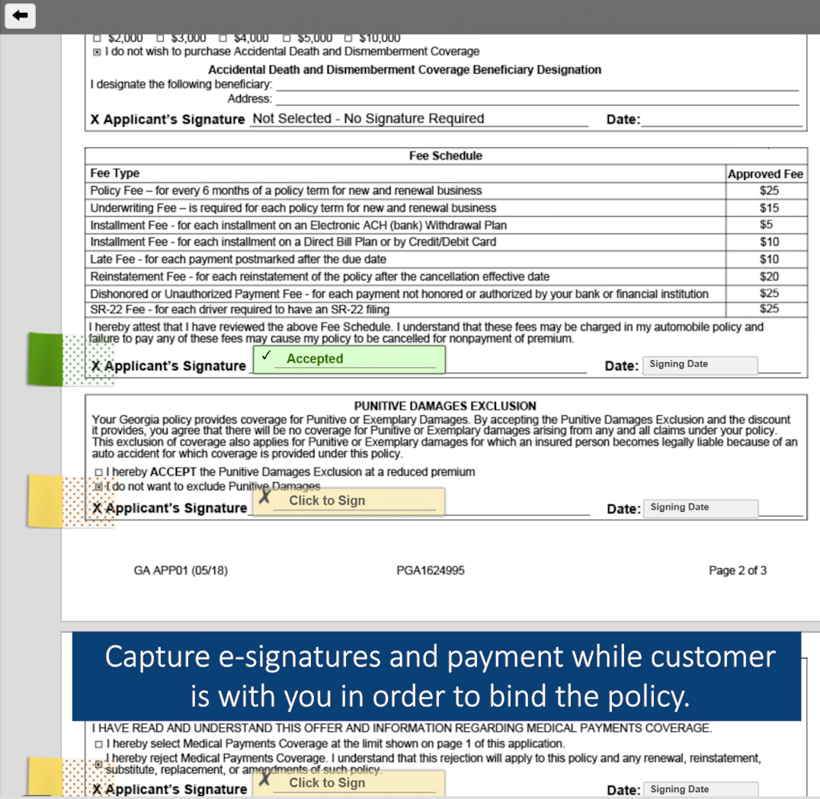
The insured will then be directed to the application where they will need to apply their signature to all the highlighted areas electronically.

Slide 15
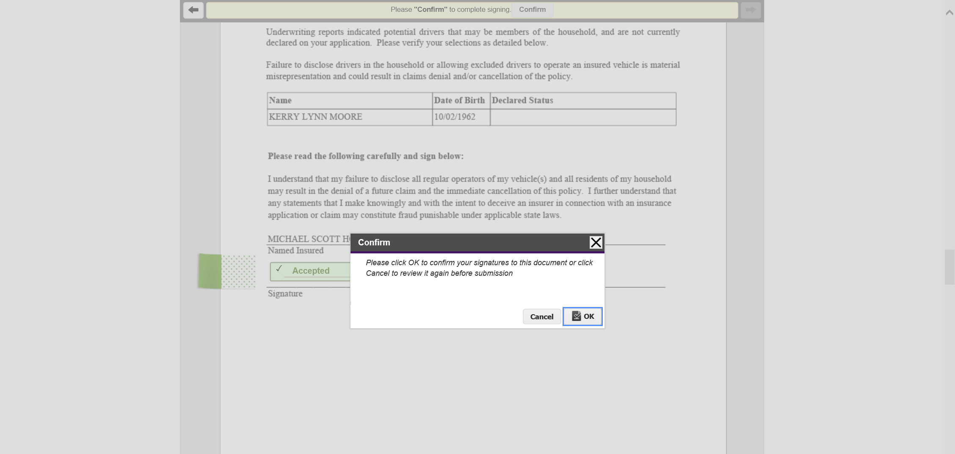

Slide 16
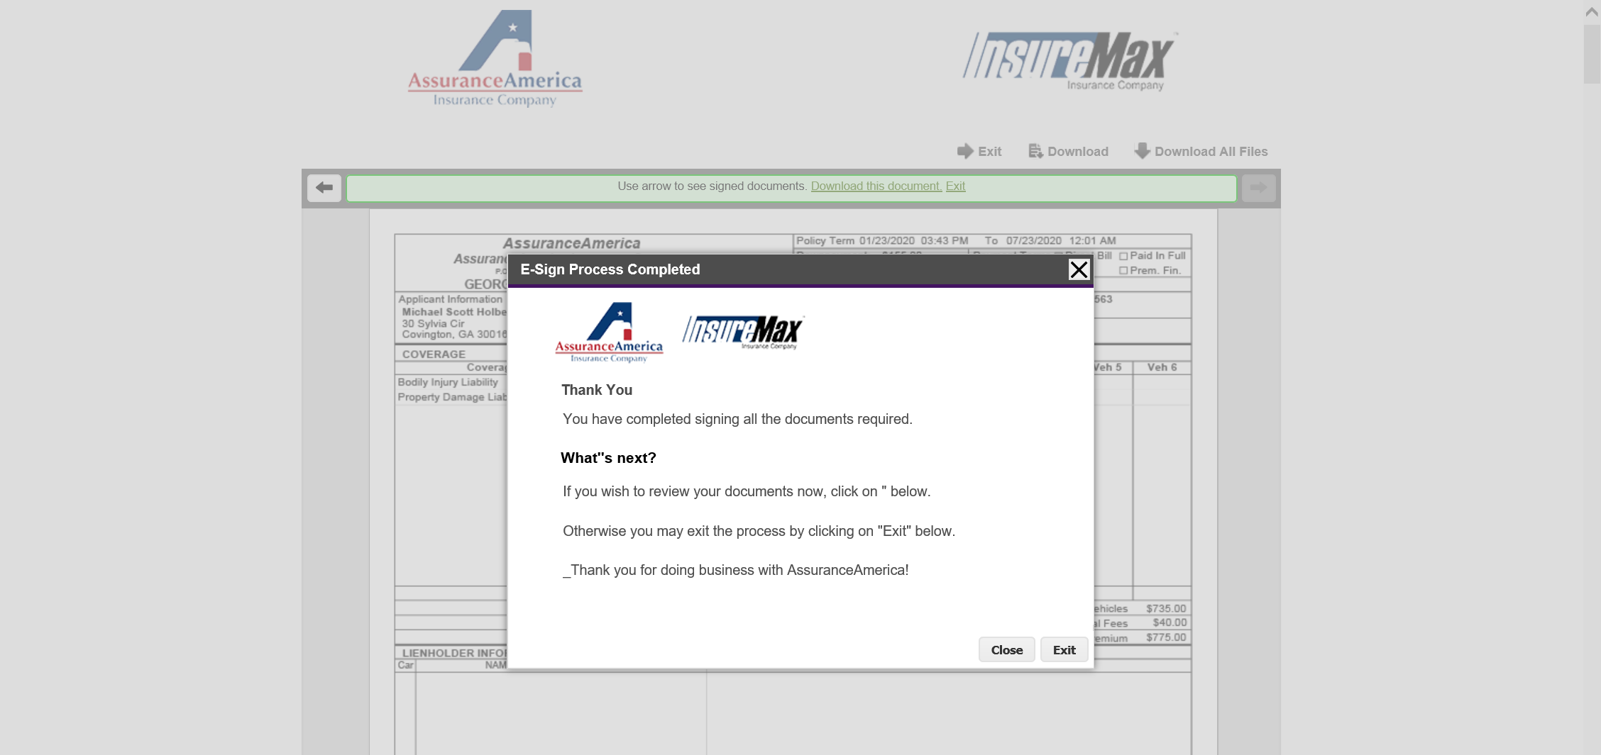

Slide 17
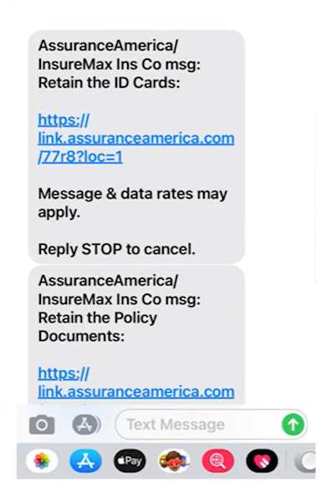
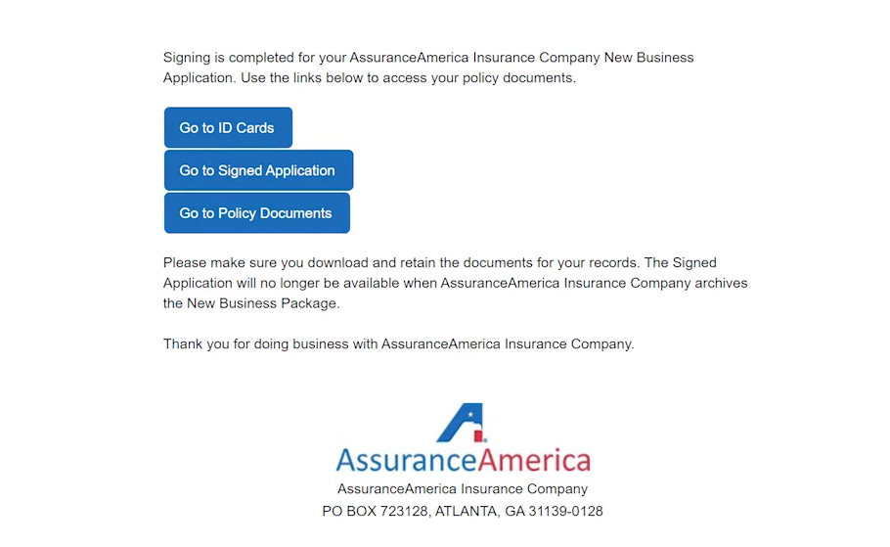
Once the forms are signed, the client will receive this 2nd email & text message containing their policy documents.
Text Message:
Email:

Slide 18
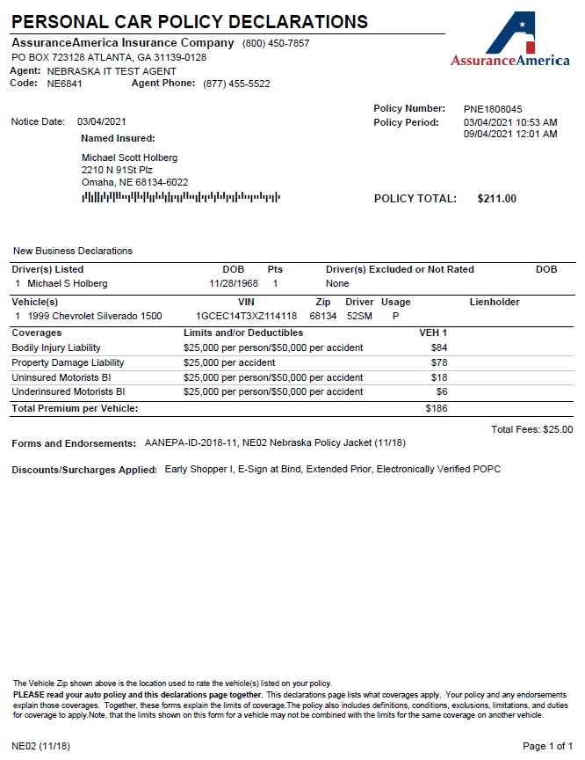
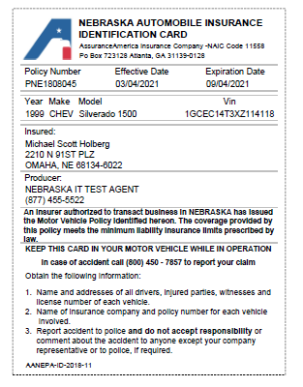
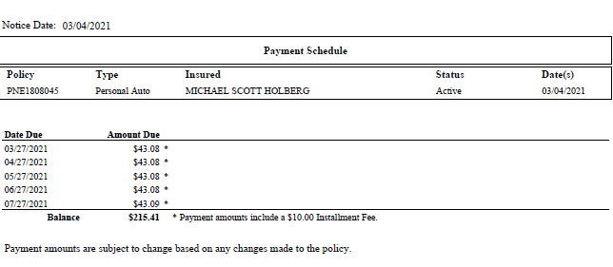
Dec Page:
ID Card:
Payment Schedule :

Slide 19
Navigating Webrater

Slide 20
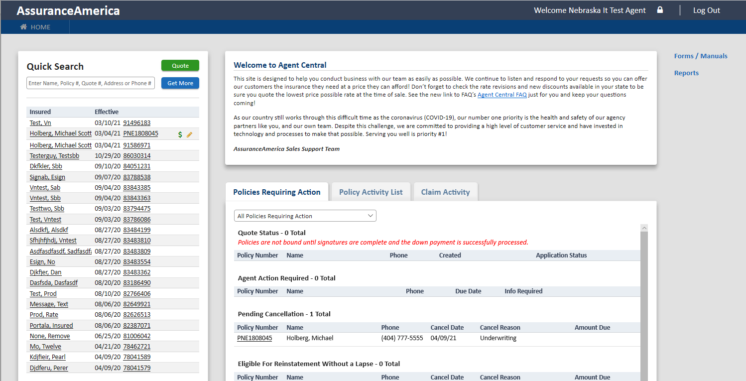
This is your dashboard. If you need to look up a specific client enter their last name, policy number, phone number or address. Then, click “Get More.”

Slide 21
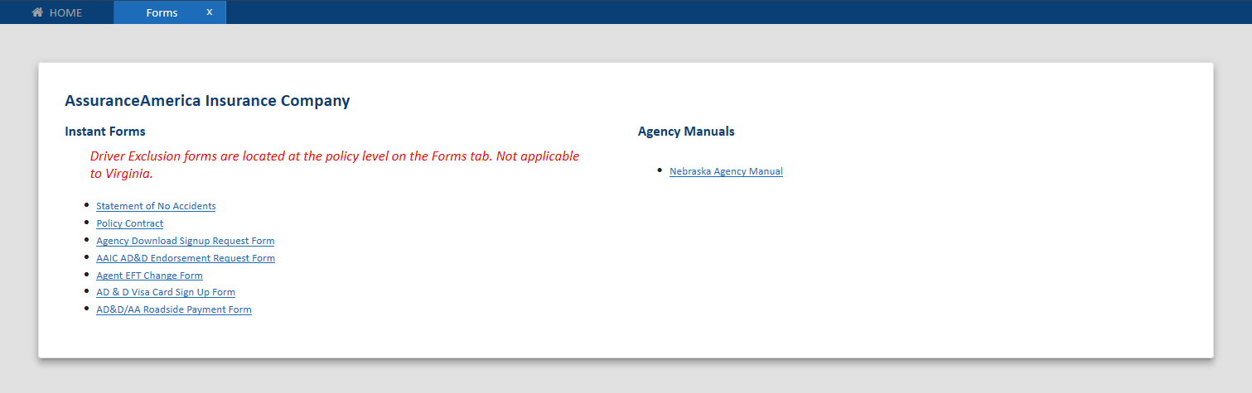
This is also where you can access various blank policy forms your client will need to fill out.
This is the list of forms:

Slide 22
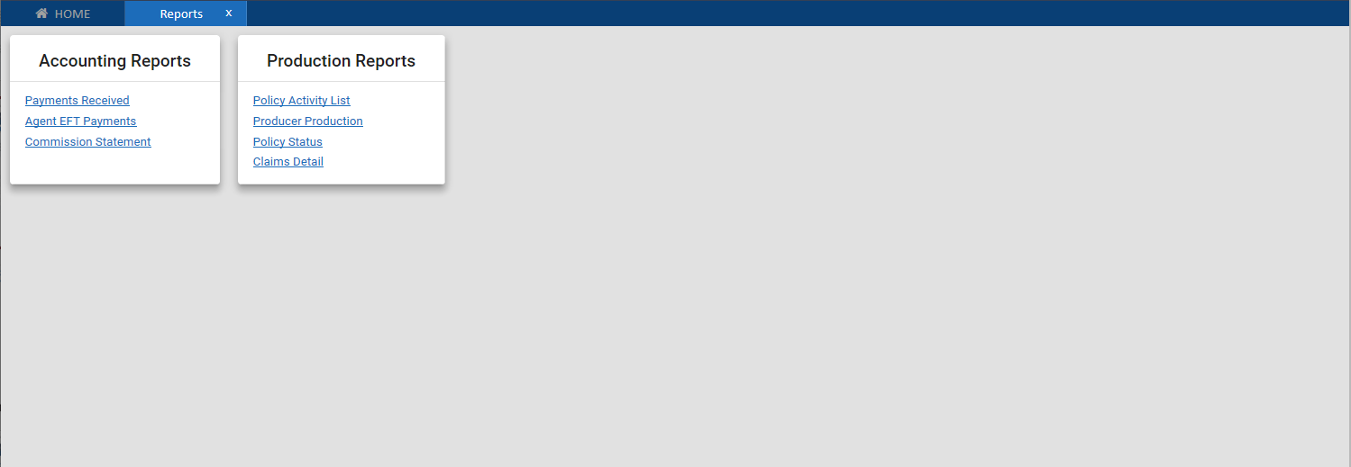
This is also where you can access various reports that your agency will find useful.
This is the list of the reports:

Slide 23
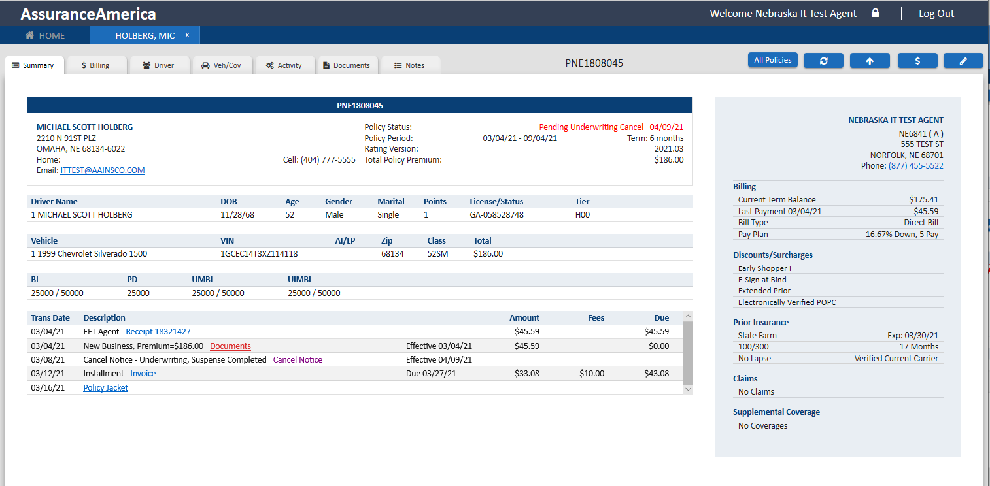
The policy summary page gives an overview of the policy.

Slide 24
Click here to upload policy forms, such as proof for discounts.

Slide 25
Click here to make a payment.

Slide 26
Click here to make an endorsement

Slide 27
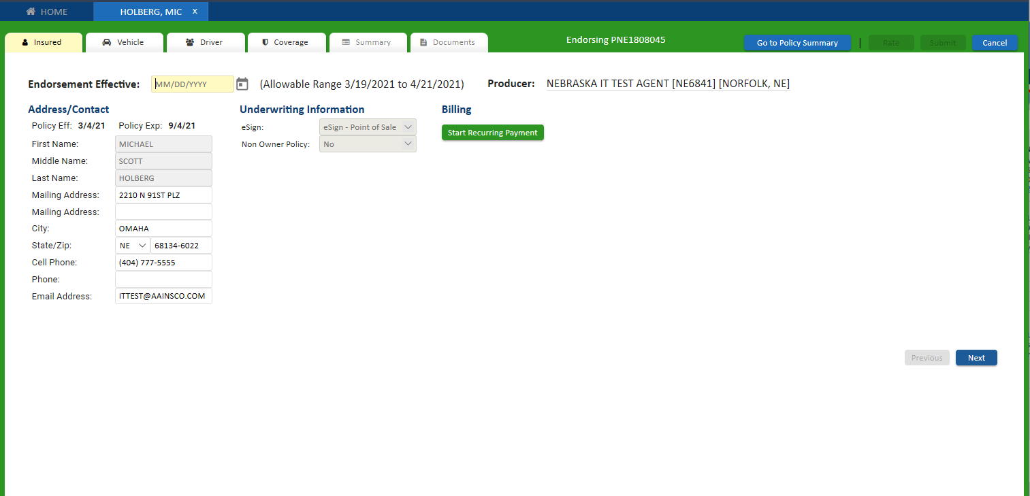
Endorsements
Recurring billing can be added or removed here. This is also where you would go to change the insured’s account information.
Enter in the endorsement effective date

Slide 28
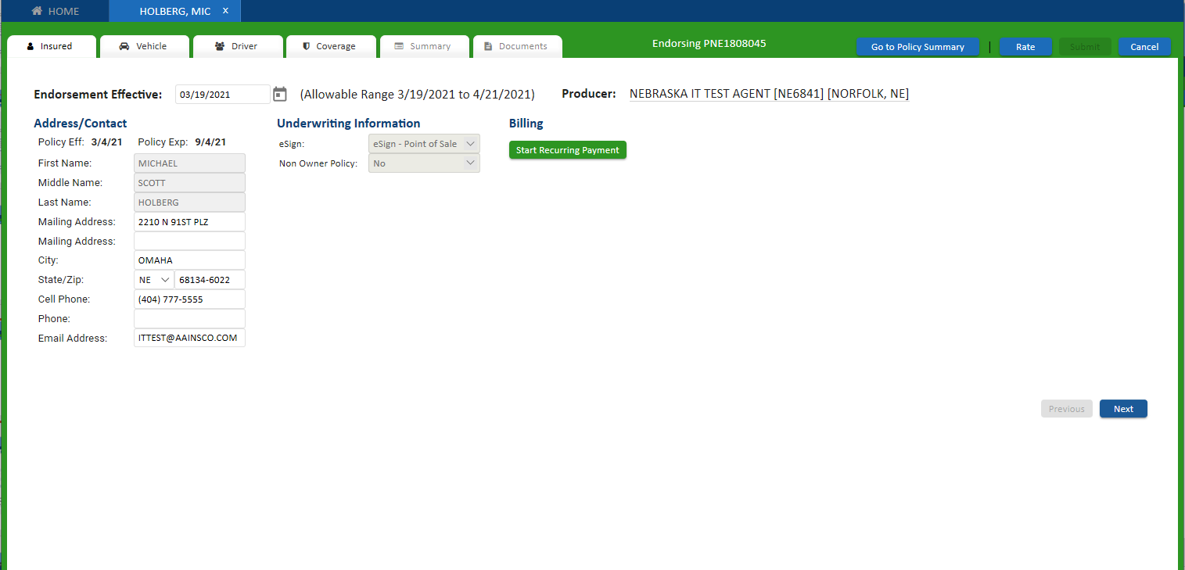
After you have made the client’s requested changes, click rate to see how the premium will be affected.
Use the Vehicle Tab to add or remove a vehicle.
Use the Driver Tab to add or remove a driver.
Use the Coverage Tab to add or remove coverage.

Slide 29
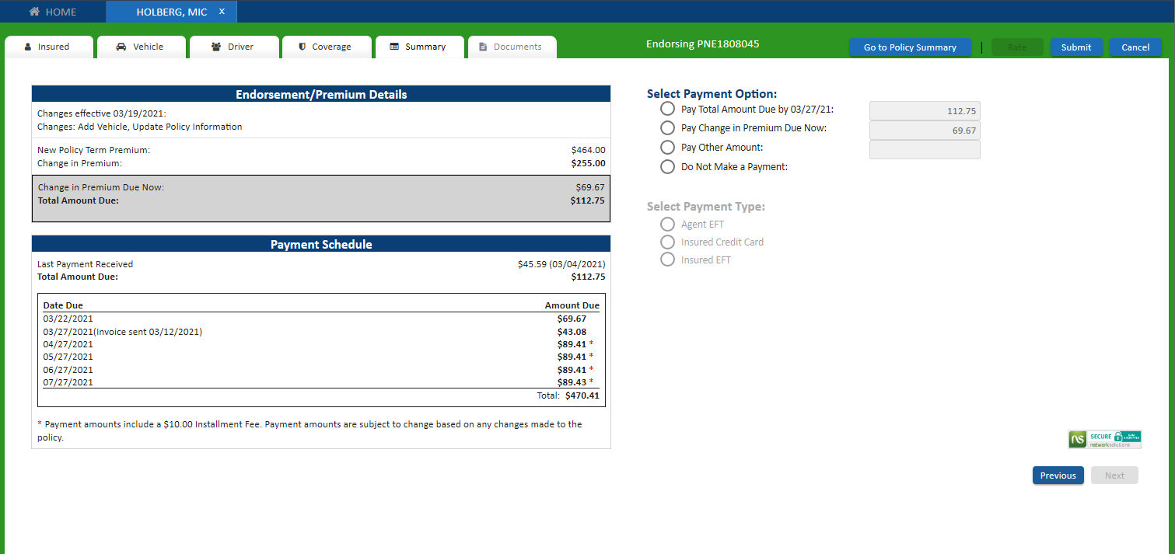
Nothing is final until you click “Submit.”
For a premium increase, use the options here to select the client’s desired payment option. If they choose not to make a payment, please advise the client that the policy will cancel within the next 7 days even if their next payment was not due yet.
This is the total amount of premium increase (or decrease) that will be divided up between the remaining payments detailed below.
For a policy premium increase, there will typically be an amount due to the time of the endorsement as shown here.
For a decrease, there will be an amount immediately refunded, which will be deducted from the next payment.

Slide 30
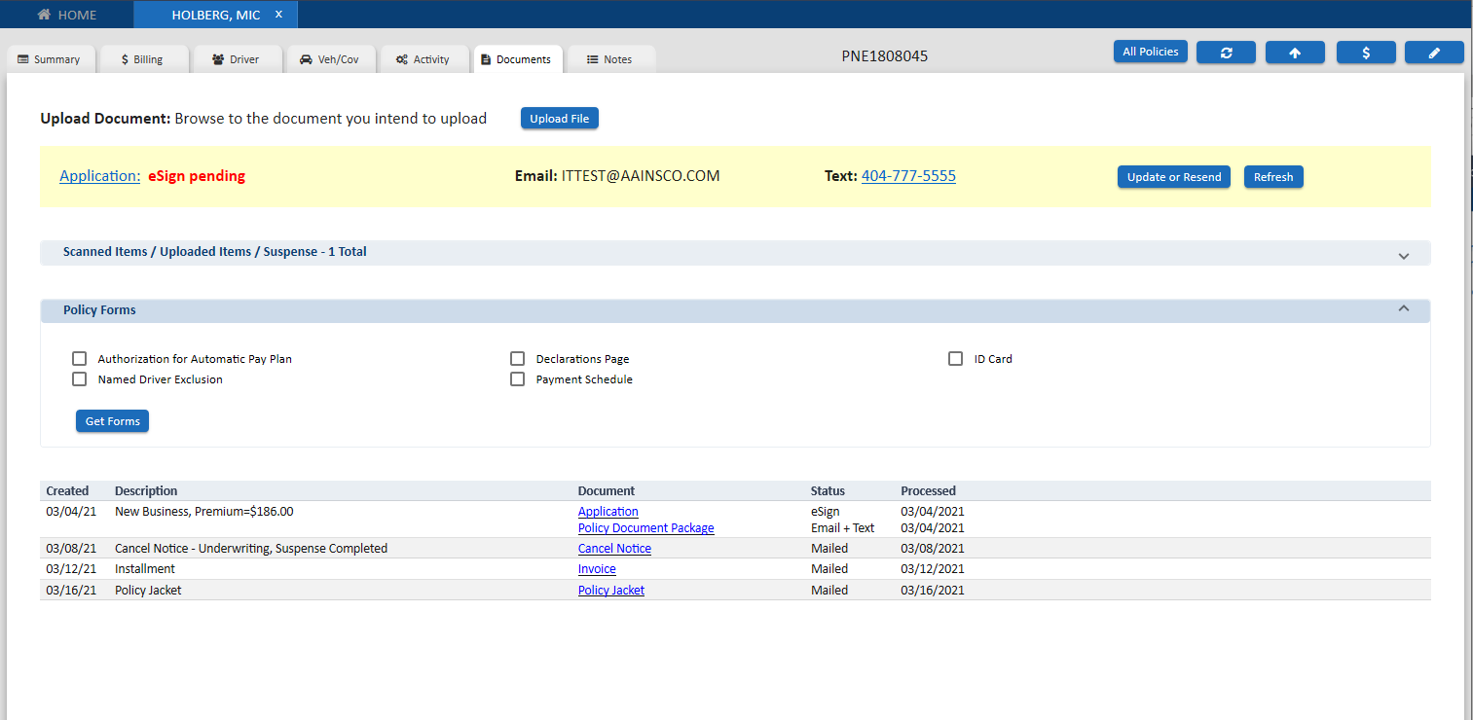
You can access and resend policy documents by opening this dropdown menu under the “Documents” tab.

Slide 31
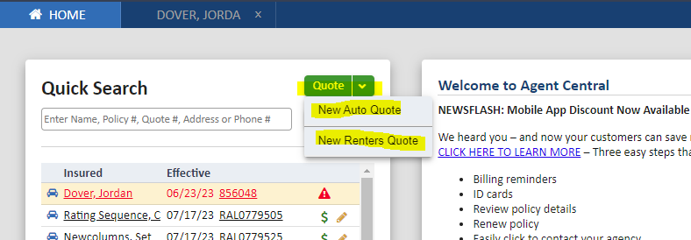
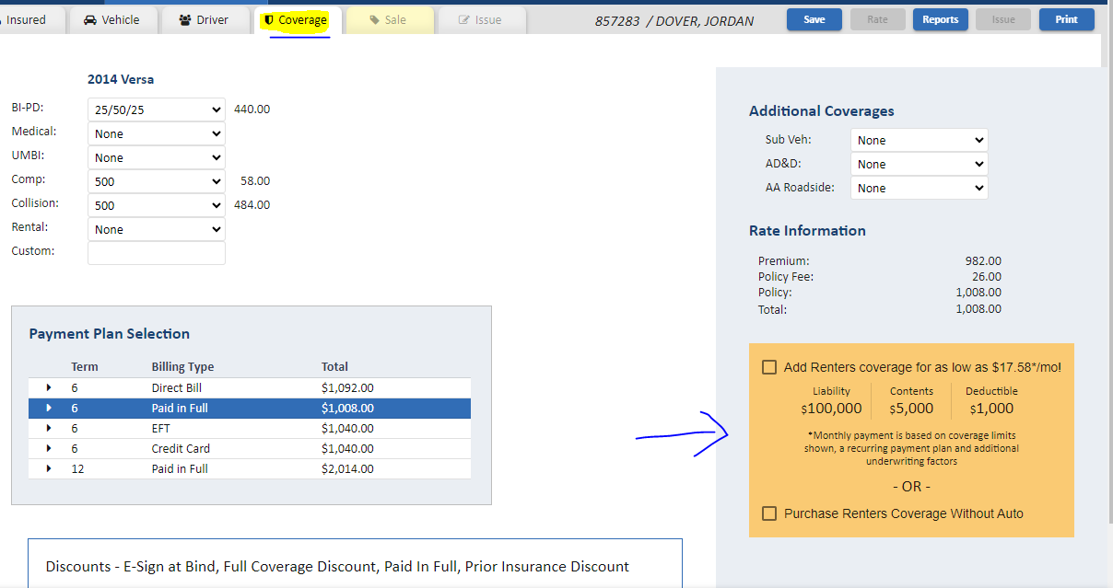
Quoting Renters:
1. If Quoting a standalone Renters policy, you will simply click the drop down next to quote on agent central (home page) and select ‘New Renters Quote’. From there you will be guided through a quick and easy process to quote and bind the policy.
2. If coupling with an Auto policy, you will have the quote pre-populate and can be added on the coverage tab of the quote. If you wish to move forward with the bundle, you will have the ability to adjust the renters quote as needed after adding it to the auto policy.

